Slide 1
Avoiding Online Cheating
Dr. Richard Jerz

Slide 2
Topics
Detection
Avoidance
Faculty Education
How can LMSs help?
Course Compass (Publisher tools)
Blackboard
Moodle
Others

Slide 3
Detection Example
Exams are to be taken independently!

Slide 4
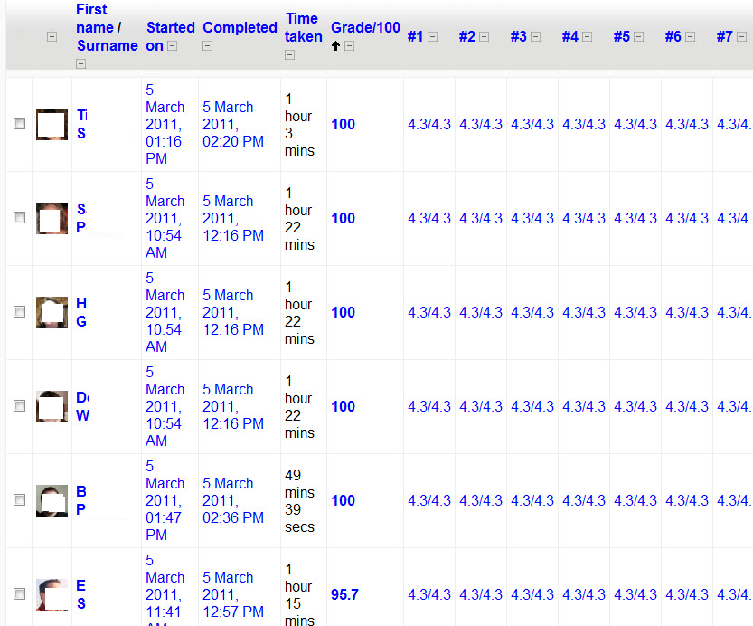
Detection

Slide 5
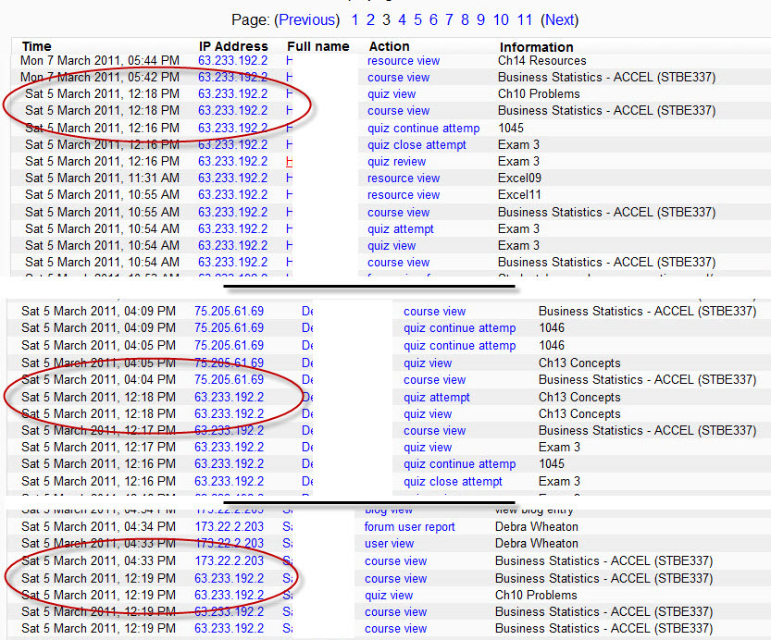
Detection - Continued

Slide 6
Detection
Time stamps
Location stamps (IP address)
Results/Scores
File sizes (where appropriate)
Anti-plagiarism tools (where appropriate)

Slide 7
Avoidance
Proctored Exams
Randomization Methods
Multiple versions
Security tools
Make exams worth less points
Miscellaneous

Slide 8
Proctored Exams
Central Location of exam
Exams at the same time
Administrative (i.e., student picks a proctor)
Remote Proctor Authentication (e.g., SoftwareSecure)

Slide 9
Randomization
Multiple exams (similar version)
Questions picked randomly
Algorithmically generated numerical responses
Publisher products

Slide 10
Security Tools
Browser security
IP security
Timed exams
Cameras
Password protection

Slide 11
Miscellaneous
For papers, picking appropriate themes
Making projects be individualized

Slide 12
Faculty Education
Examples (anonymous, of course)
Randomization techniques

